Slide 1
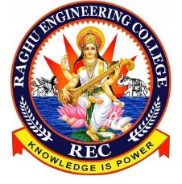
RAGHU ENGINEERING COLLEGE
(AUTONOMOUS)
DEPARTMENT OF EEE
Academic year: 2018-2019
II year 2-semister
ENVIROMENTAL SCIENCE
CASE STUDY
ON
MINERAL RESOURCES
ENVIRONMENTAL IMPACT OF MINERAL EXTRACTION AND USES
FACULTY:
Mr. Ravi Kumar
Associate professor
BATCH-3
18985A0246 – K.Karthik
18985A0247 – L.Ratnakara Rao
18985A0248 – M.Gaddim Naidu
18985A0249 – M.Jagapathi varma
18985A0250 – M.Sai

Slide 2
INTRODUCTION:
For any nation, minerals are back bone for economic growth and india has been eminently and enormously endowed with this gift of nature. Evidences that exploitation of minerals like coal, iron -ore, copper, lead-zinc has been going on in the country from time immemorial. The history of mining goes back thousands of years. It became important in industrial revolution in 19th and 20th centuries. The first ever recorded history of mining in india are permissions granted by East india company for mining coal in Raniganj before 1774.
Mineral extraction is main back bone for todays technological developments and new technologies , every tool and machine must require to be manufactured and utilized by the means of minerals like commercial (iron , gold ,aluminium ,silver ,bronze ,brass all metallic elements .), energy generating (uranium, petroleum , CNG ,coal.)

Slide 3
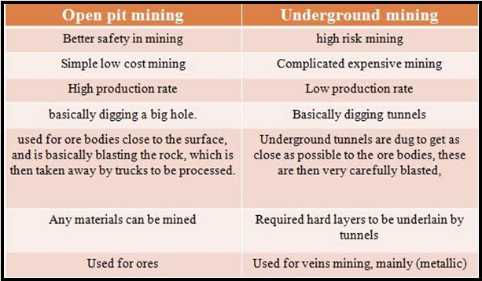
TYPES OF MININGS:
1.Open pit mining /open cast mining and 2.Underground mining.

Slide 4
IMPACTS OF MINING:
Physical Impacts
1.Land subsidence
2.Underground fires
Land scape destruction
3.Soil erosion
Ecological impacts
1.Deforestration
2.Loss of flora and fauna
3.Ecosystem degradation
Negative socio economic impacts
1.Enroachment and evacuations
2.Resesstlement and rehabilitation issues
IMPACTS OF MINING
ACTIVITIES
Occupational and health impacts
1.Health hazards due to long term exposure to hazardous chemicals
2.Accidents
Positive socio economic impacts
1.Employment
2.Infrastucture facilities
3.Economic gains
Environment pollution
1.Air pollution
2.Water pollution
3.Soil pollution
4.Noise pollution

Slide 5
Adverse Impacts of Mining
Significant waste materials (waste rock and tailings) are generated that are generally toxic;
Unsafe disposal of waste materials can cause long-term environmental impacts;
Breakdown of traditional structures and values;
Increase in cash flow and economic activities can contribute to social problems such as increase in drunkenness and family related problems;
Rapid social change associated with mine development widens the gap between the ‘haves’ and ‘have-nots’.
4

Slide 6
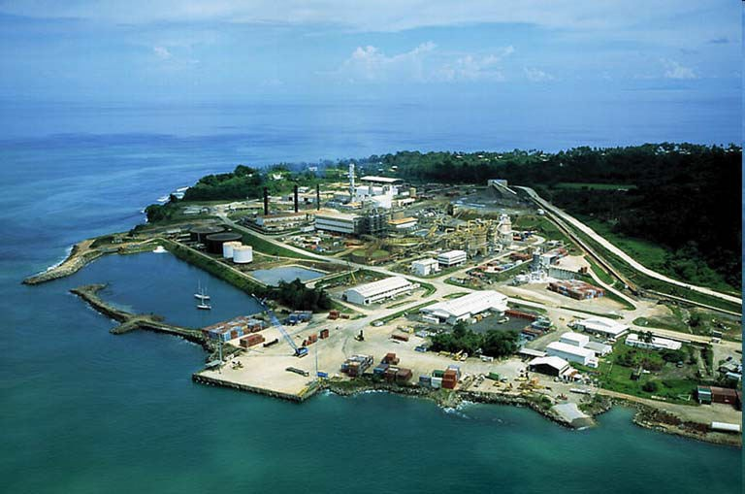

Mine Infrastructure
37
Processing plant,
Port facilities,
Airstrip,
Diesel and geothermal power stations,
Water supply facilities,
Camp and town site accommodation,
Access roads,
A communication system.

Slide 7
Comparison of Terrestrial and Offshore Mining
Terrestrial | Marine
Significant overburden | Huge water body (ocean) that needs to be dealt with
Generate significant amount of waste (overburden, tailings, leachates) | Reasonably less amount of waste generated
Huge footprint | Small footprint (SMS) Reasonable footprint (MN & CRC)
Often isolated and difficult to access | Located within territorial waters and EEZ
Huge infrastructure development | Far less infrastructure to be built
Acid Rock Drainage | Sulphuric acid cannot form in ocean (seawater being “alkaline”)
Complex resource ownership system | Common heritage of the nation
Reasonable knowledge of environment | Limited knowledge of environment

Slide 8
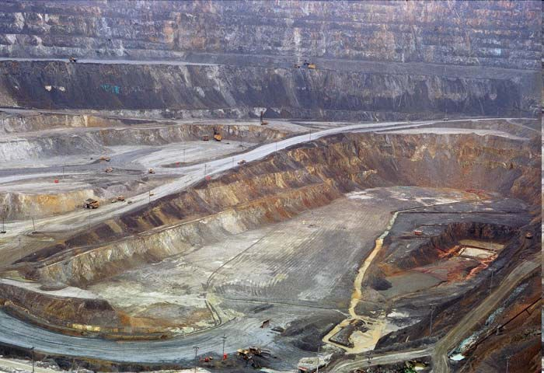
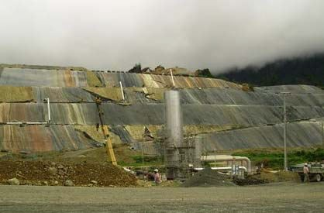


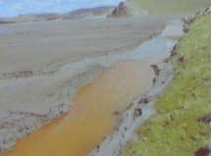
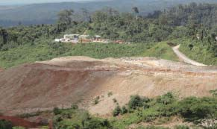


Wall and floor of the open pit
Ore Stockpile
(Tailings containment sites)
Waste Rock Stockpile
20

Slide 9
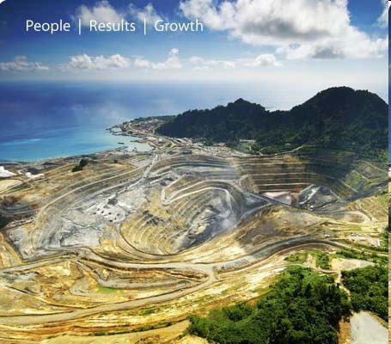
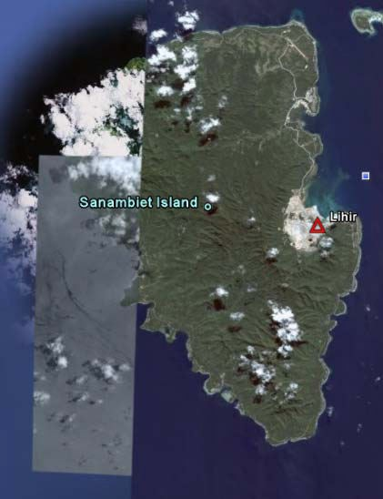

Gold Mine – Open Pit
36

Slide 10
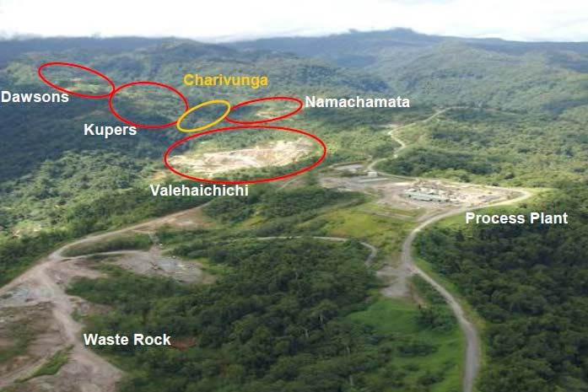
Aerial View of Gold Ridge
4
7

Slide 11
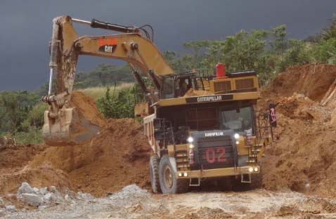
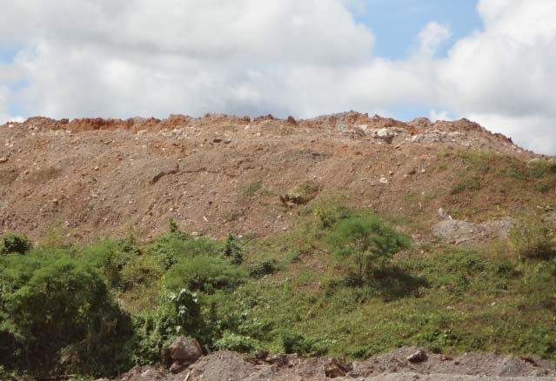
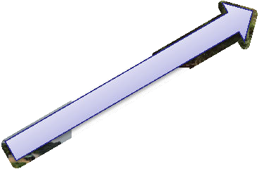
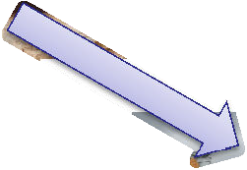
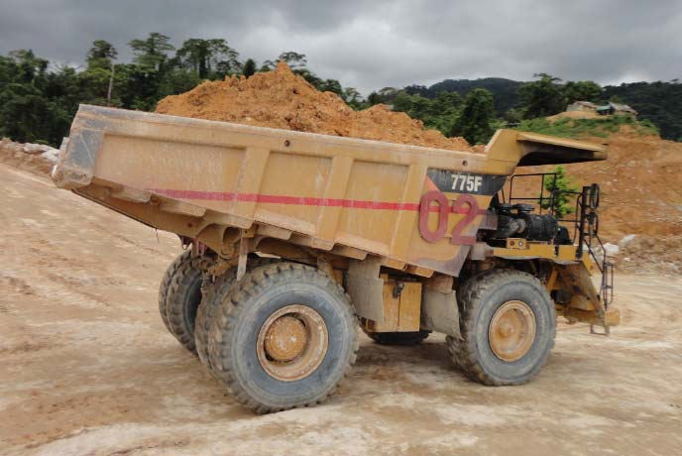
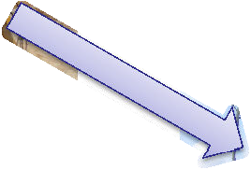
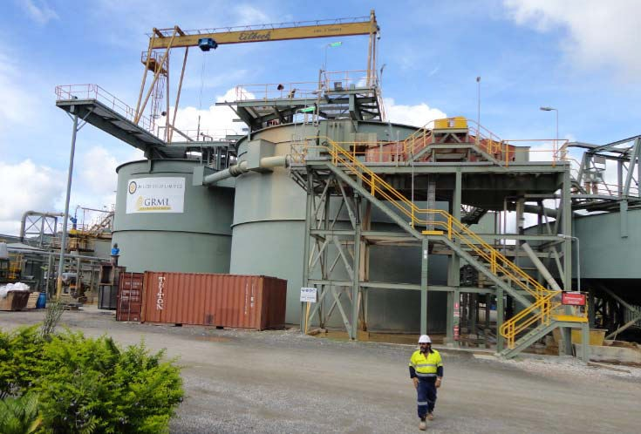
Mining steps
Extraction
Waste Stockpile
Processing Plant
48
Haulage

Slide 12
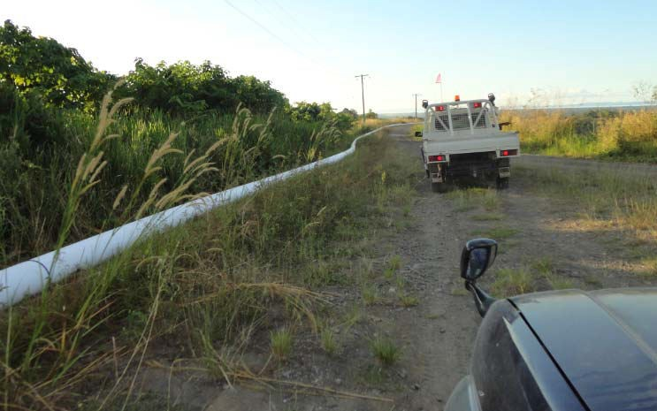


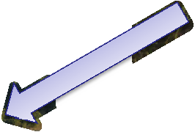

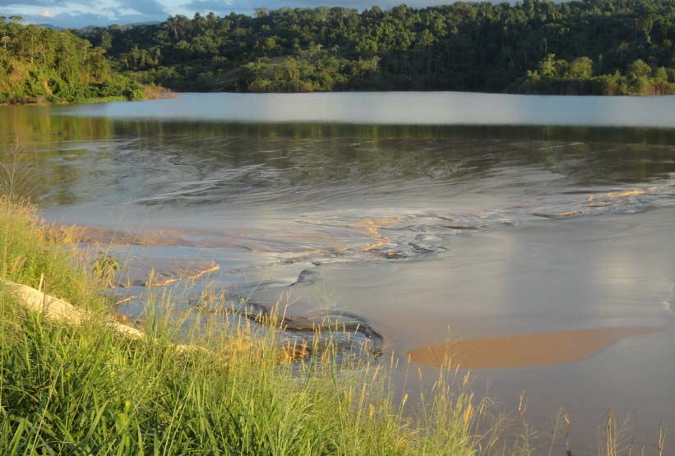
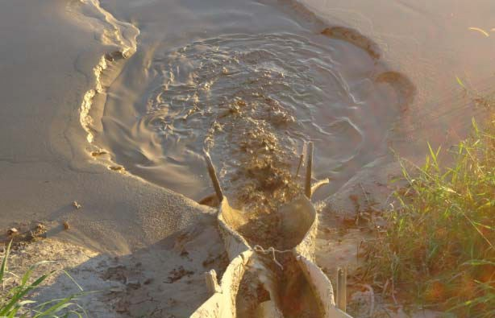
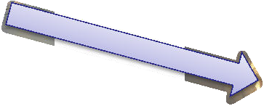

Waste deposals
Processing Plant
Tailings Pipeline Tailings Disposal
Tailings Dam
49

Slide 13
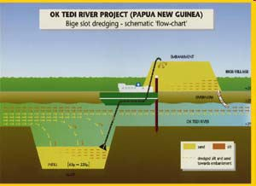
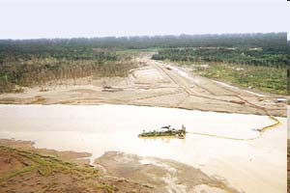
Dredging as a remedial measure…
To reduce flooding and vegetation dieback,
Dredge 20Mt of sediment per year,
Vegetation recovery has improved since the commencement of dredging.

Slide 14

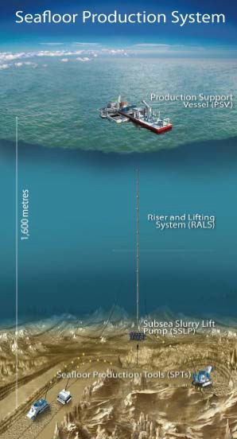
Deep Sea Mining Process…
Slurry discharge,
If the SPS is efficient and robust, there is less likely to be any significant impacts of SMS mining.
transfer of ore, and treatment of effluent
Return of treated effluent to the ocean floor
The performance of the SPS will only be known during actual mining
(Pumping of ore slurry (crushed ore materials
+ seawater)
Disaggregation, crushing and collection of ore

Slide 15
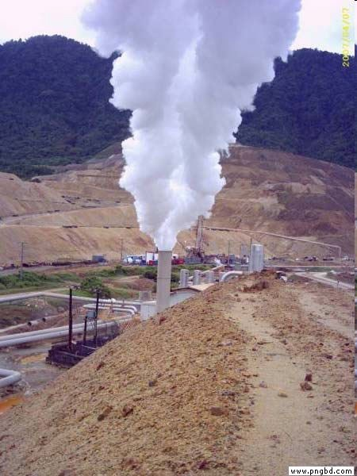
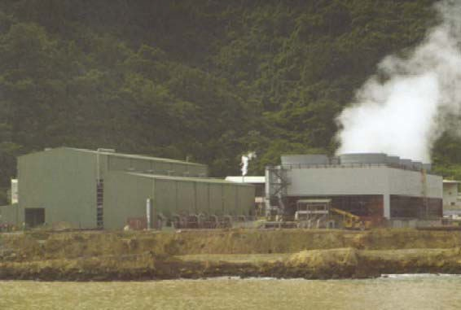
LGL – Geothermal Power Resource
Supplementary power production using geothermal steam – a by-product of mining,
Commenced in 2003 with a 6 MW geothermal power plant,
The Lihir Geothermal Power Plant (LGPP) now produces 56MW power,
Represents 75% of the 75MW power requirement of the mine.
Save US$40 million in the cost of diesel fuel per annum.

Slide 16
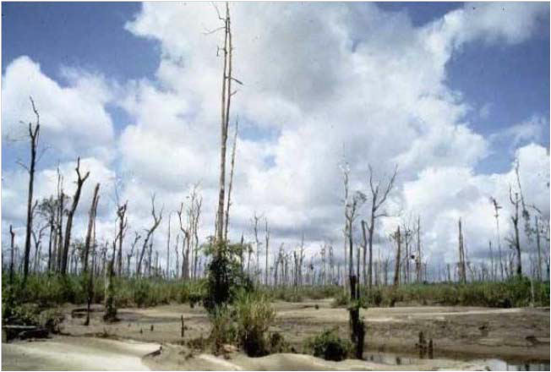
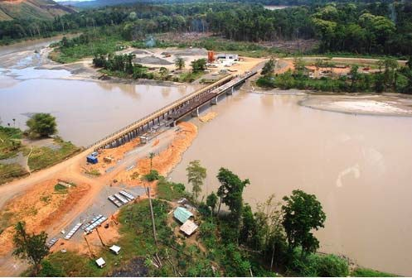


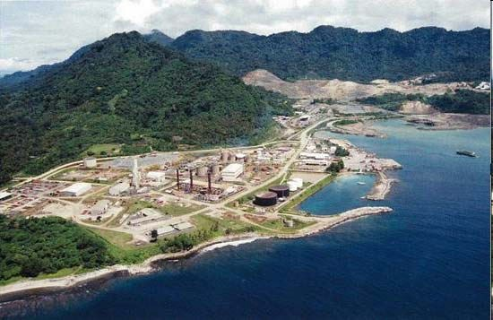
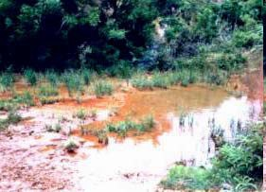


Environmental Impacts of mining…
Vegetation Dieback
Bridge construction
5
Processing facility
Acid Rock Drainage

Slide 17
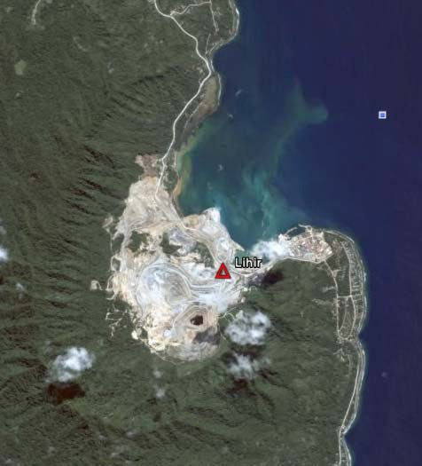
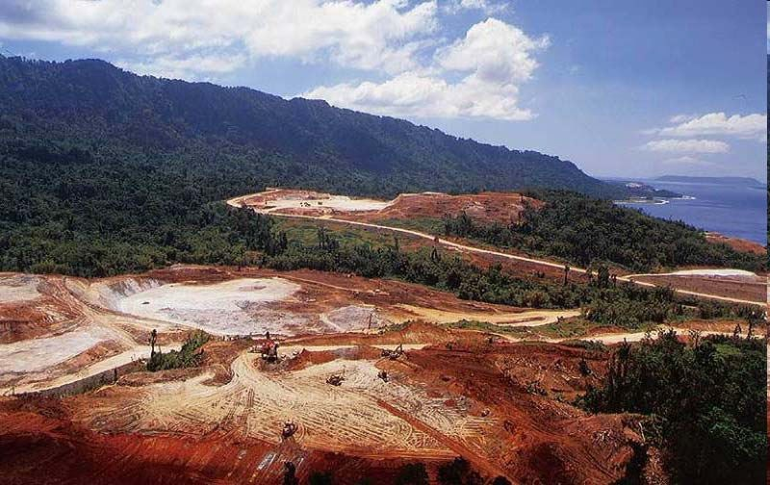

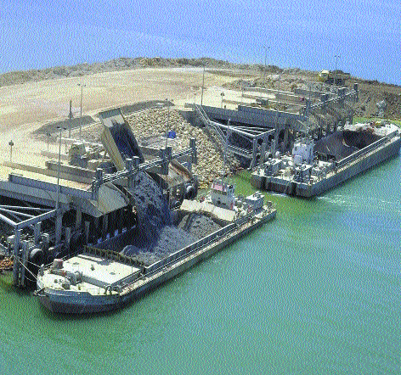
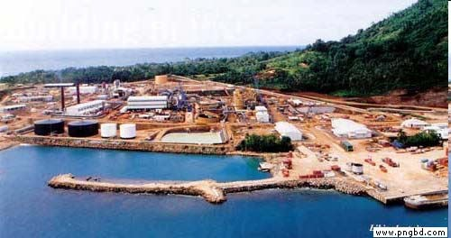


Mining Impacts on terrestrial and seas
Terrestrial and marine impacts
Massive clearing of vegetation
Significant infrastructure development
Waste rock disposal

Slide 18
Mining Waste
The management of mine waste is often externalized – passed from the mining operation to other parties or the public.
This waste if not properly controlled, can result in the smothering of surface waters, contamination of ground waters, and the release of hazardous substances.
Metal Mining
Major mining waste comprises the following:
waste rock,
tailings,
acid rock drainage,
fuel/oil/greases,
dust and silt,
sewage,
Sulphur and toxic gases given out from the mill chimney.
6

Slide 19
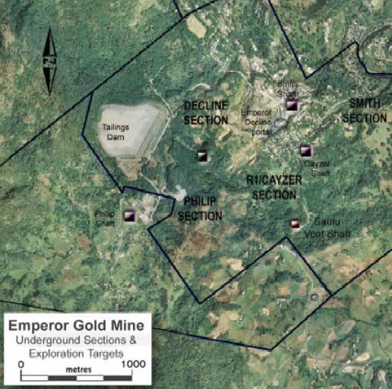
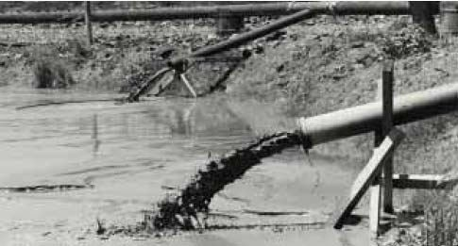
Mine Waste Disposal Methods
A number of waste disposal methods are used globally:
Tailings dam,
Landfill,
Backfill,
Riverine,
STD/DSTP,
Thickened Tailings.
9

Slide 20
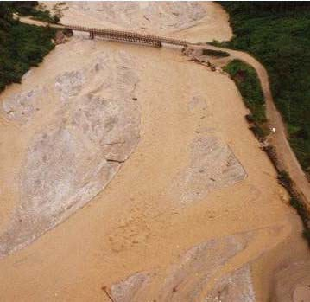

Common Impacts of Riverine Waste Disposal
Significant increase in river sedimentation,
Destruction of river biodiversity (e.g. fish species),
Destruction of water source for local communities,
Loss of productive wildlife habitat (e.g. vegetation dieback),
Long-term impacts and recovery (e.g. ARD),
Costly to address through remedial
Ok Tedi
21

Slide 21
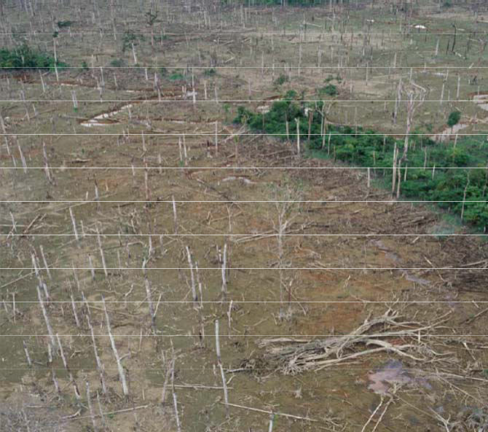
Vegetation Dieback…
Most obvious consequence of sedimentation in the river system,
Excess sedimentation has caused the reduction of oxygen levels in the roots killing vegetation,
Estimated Vegetation dieback coverage:
- 1992: 18 km²,
- 2000: 480 km².
32

Slide 22
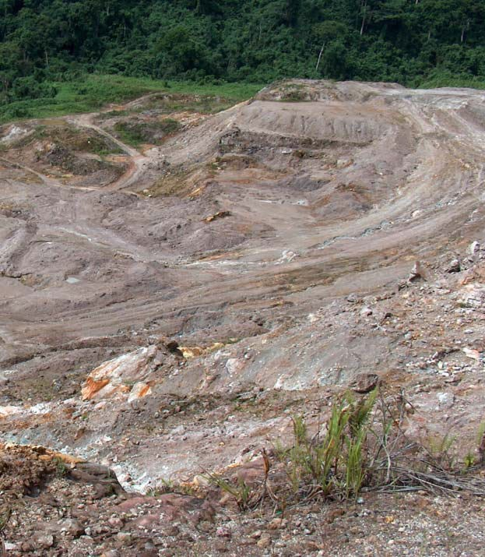

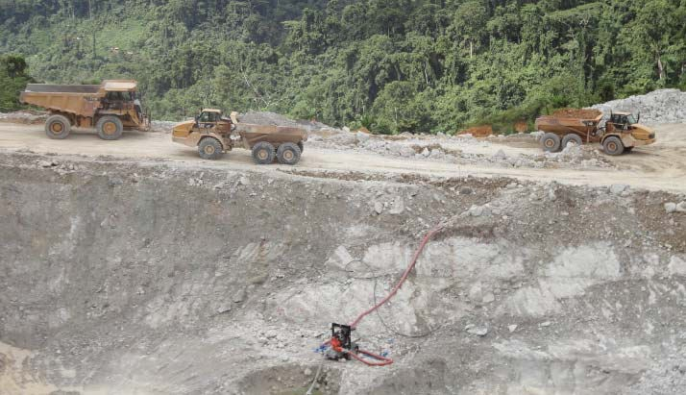
Mining Waste Produced Depends on…
Gold Ridge, SI
Geological characteristics of the orebody,
Type of mining (underground vs open pit),
Minerals being mined (chemistry of the orebody and host rocks),
Size of production.
14

Slide 23
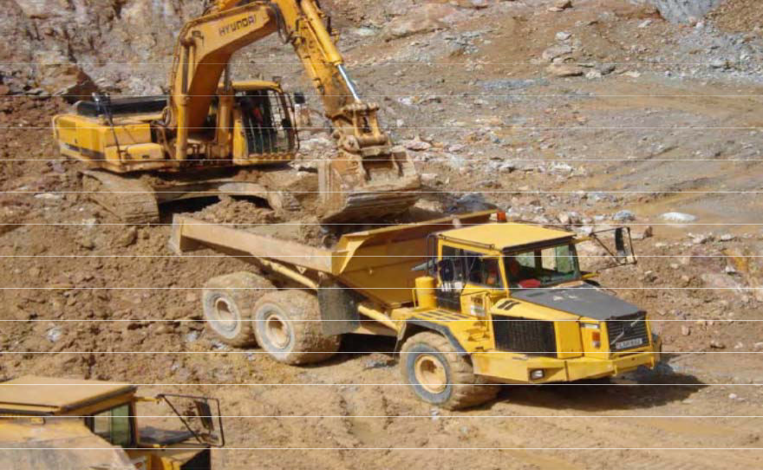

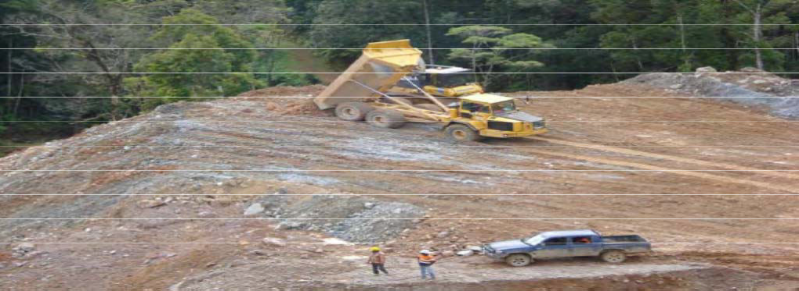

Waste Rock Characterisation
Waste rock contains…..
hard and soft rocks,
small gold/copper etc. concentrations too uneconomic to process,
fuel, oil and greases,
explosives,
measureable concentrations of other metals such as arsenic, cobalt, nickel, mercury, lead, zinc, etc.
Waste Loading – Mt Sinivit Gold Mine, East New Britain
Waste Dumping
16

Slide 24
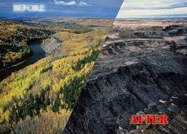
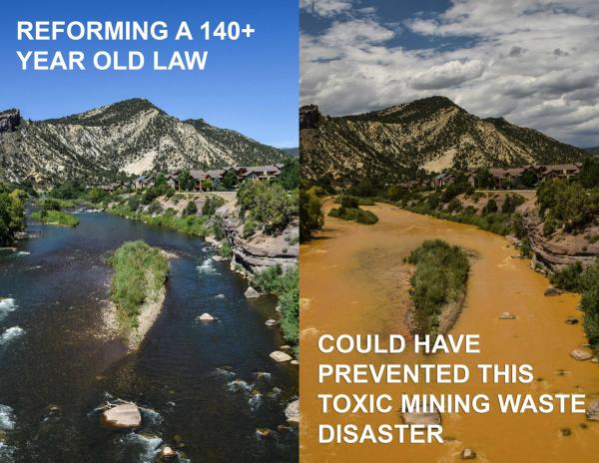
Effects of mines on nature
Nature scenery Before and after mining
Water pollution due to toxic wastes mixed in water

Slide 25
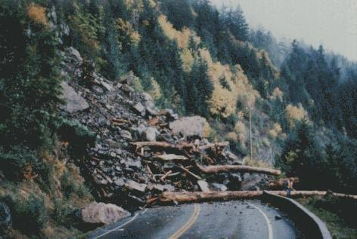
Effects of underground mining:
Land sliding
Earth quakes
Human deaths due to mine collapse
Underground water pollution

Slide 26
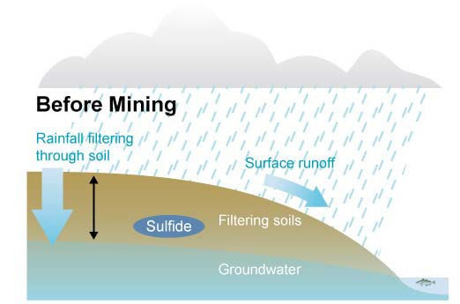
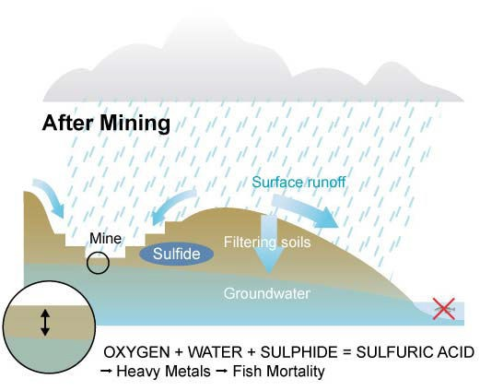
Mining effects on Rainfall Drainage
http://maps.grida.no/go/graphic/graphicid/CAC 405C6-14BD-981C-634C-A29FC952D0EC
18
Extraction decreases groundwater depth and natural filtration, and increases groundwater contamination.

Slide 27
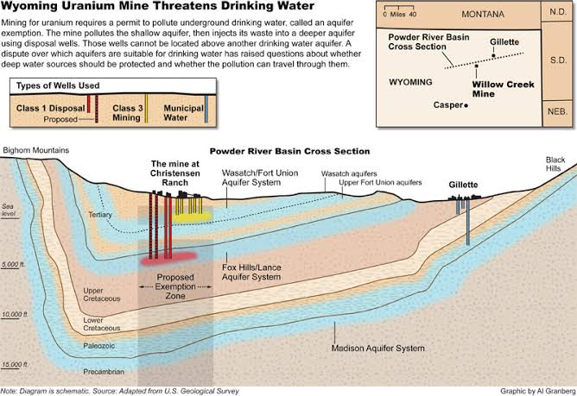
Effects on water resources due to Uranium extraction:

Slide 28
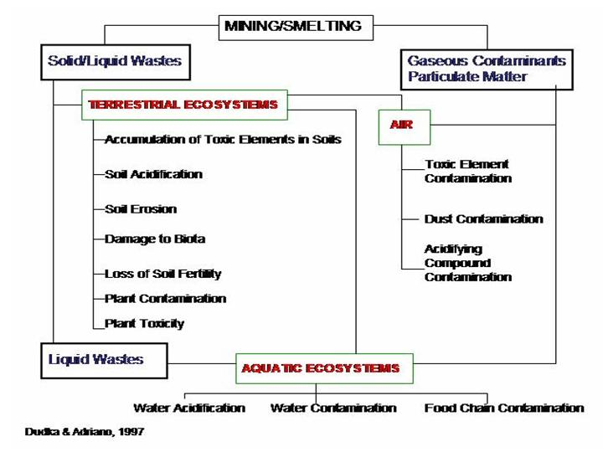

Slide 29


Humanity violations: 1.Formation of Rebellions 2.naxalite 3.terrorists 4.illeagal activities

Slide 30
DIFFERENT MINES IN INDIA:
Jaduguda uranium mine, JHARKHAND
Jharia coal mines,JHARKHAND
Sukinda chromite mines, ODISHA
Kundremukh iron ore mine, KARNATAKA
East coast bauxite mine, ODISHA
North east coal fields,ASSAM

Slide 31
MINING COMPANIES IN INDIA:
NCDC-National Coal Development Corporation of india.
NMDC- National Mineral Development Corporation of india.
BALCO-Bharat Aluminium Company.
PPCL-Pyrites, Phosphates and Chemical Ltd.
HZL-Hindustan Zinc Ltd.
NLCL-Neyveli Lignite Corporation Limited.
HCL-Hindustan Copper Ltd.
BGML-Bharat Gold Mines Ltd.
SAIL-Steel Authority of India Limited(formerly Hindustan Steel Ltd.)
MINING COMPANIES IN WORLD:
Glencore Xstrata public Ltd., switzerland, United Kingdoms
BHP Billiton , Melbourne, Australia
Rio Tinto MNC, United Kingdom
China Shenhua Energy, China
Vale, Brazil

Slide 32
Table 5–2. Competing Metals or Materials in Some Large End-Use Applications
Industries | Competing metals/material
Transport:
Motor vehicles | Cast iron and steel are used in the construction of motor vehicles. The need to reduce the weight of
 | automobiles has led to the introduction of aluminium in engine parts and increasingly in body parts.
 | Aluminium offers the same or better strength with lighter weight compared with steel, although the cost of
 | aluminium per tonne (four or five times more than steel) is prohibitive. The steel industry has responded by
 | demonstrating that cars can be built of steel and still achieve much of the weight savings associated with
 | cars containing high proportions of aluminium. Other materials, such as magnesium and engineering
 | plastics, are also competing for use in automotive components.
Aircraft frames | Aluminium won its first mass market when it was used as an alternative to balsa-wood in the manufacture
 | of airframes.
Telecommunication:
Cables | Copper lost part of this market to optic fibres, which are now used for new installations between major
 | centres. Optic fibres are increasingly used in the branch connections, but copper remains the favoured
 | material for the final connection to the end-user. Mobile telephones pose a new challenge, since no
 | cabling is required.
Electrical transmission | Aluminium competes with copper, having won the market for overhead conductors. The lower resistivity
 | of copper, however, makes it more effective as a conductor where space is restricted, hence its virtually
 | unchallenged market for house wiring and power cables that are laid under ground.
Packaging | Tinplate was the first material to be used to make beer cans. Aluminium gradually made great inroads into
 | this market, to the extent that tinplate was eliminated from this end-use in the US and to a large extent in

Slide 33


Slide 34
Construction: Roofing Galvanized steel has always been seen as the simplest and cheapest form of metallic roofing or panelling for buildings. It tends to be replaced with better-looking or more technically efficient products as incomes rise. This market is heavily influenced by climate, tradition, and the skills of the local building trade. The selection of material depends in part on the willingness of the consumer to pay a higher price for a longer- lasting material. It also depends on the training and skill of the local building trade with each material. Copper is widely used in Germany and Central Europe, where snowfall is heavy. Zinc is traditionally favoured in France and Belgium, while the UK market prefers lead. Alternatives include slate, tiles, and roofing felt. Window/door frames Aluminium displaced steel and wood in window and door frames, but has more recently lost some market share to plastic window frames. The deciding factors are product design and the performance of the product when exposed to variations in temperature and climate. Residential housing Structural steel competes with timber in the construction of residential housing. There has been a campaign to promote steel-framed houses, especially in the US, but so far without any great success.
Heat transfer Aluminium competes with copper in this sector and particularly in car radiators, where aluminium has been successfully promoted. Plastic plumbing tube has also taken some market share from copper and brass, chiefly on the basis of price.
Coins Copper alloy coinage is threatened in some countries by aluminium and zinc, and more widely by the use of notes rather than coins. The use of credit cards in place of cash is also a form of substitution.
Batteries Lead competes with other materials in the development of batteries for electrically powered automobiles. The lead-acid battery is bulky, has a limited capacity (and therefore range), and needs time to be recharged. Many alternative battery technologies for the motive force in electric cars are being considered, including: solid oxide fuels cells, hybrid fuel cell-battery combinations, metal hydride batteries, zinc-air batteries, and lithium ion/polymer batteries. Fuel cells probably offer the most promising prospects, but none has yet achieved commercial acceptance compared with lead on any wide scale. Lead still dominates the market for conventional starting, lighting, and ignition batteries, the major market for lead.
Engineering In engineering applications, the choice of materials is determined partly by tradition and familiarity, but also very much by production engineers who work on the selection of the most cost-effective and technically suitable material for components. material becoming available for recycling each year the sorting and recovery of aluminium. In 1997, over

Slide 35
Thank you

